Slide 1
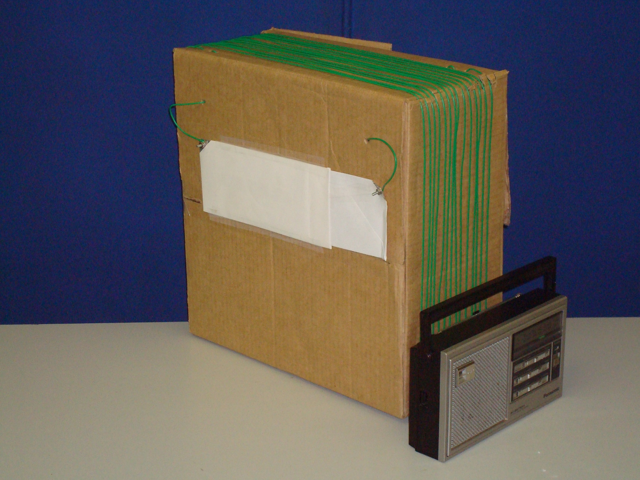
4. Rotate box antenna and radio together for strongest signal or to reduce interference
2. Slide in and out for loudest sound
3. Move radio around box sides to find strongest position and angle
1. Put radio next to loop. Tune radio to station

